Slide 1
CST8177 – Linux II
Disks, Filesystems

Slide 2
Today’s Topics
sudo and PATH (environment)
disks
partitioning
formatting file systems: mkfs command
checking file system integrity: fsck command
/etc/fstab
mounting file systems: mount command
unmounting file systems: umount command
lsof and fuser

Slide 3
Executing a command (review)
builtin command (part of the shell itself, so there's no notion of "where" the command is)
echo "Hello world"
exit 2 # inside a script, for example
by absolute pathname (does not depend on PATH variable):
/bin/ls -l
/usr/sbin/useradd newuser
/usr/bin/sudo –i
"$HOME"/bin/myscript.sh # shell expands $HOME so this is really /home/username/bin/myscript.sh

Slide 4
Executing a command (cont'd)
by relative pathname (does not depend on PATH variable, but DOES depend on your current directory – interactive shells only)
You MUST NOT do any of these in a shell script
./myscript.sh # script is in current directory
../myprogram # script is in parent directory
../../somedir/anotherscript.sh # two dirs up, then one directory down
bin/mycommand # assumes "bin" is a directory in the current directory

Slide 5
Executing a command (cont'd)
using the PATH environment variable
ls -l
cp foo ../bar
rm ../bar/foo
none of these commands will run unless they reside in a directory that is listed in the PATH environment variable
Now that we are using root privileges, we need to be aware that root can have a different PATH than your non-root user

Slide 6
sudo and your environment
sudo command # just run the command
you get 5 min by default to invoke sudo again without password
example$ sudo head /etc/shadow
sudo –s # superuser shell with current env
sudo –i # simulate root login (root's env)
sudo –s leaves you in the same directory, and with the same PATH
to take on root's environment including PATH:
sudo –i
or
sudo –s followed by su -

Slide 7
Disks and disk management
partitioning
formatting file systems
mounting file systems
/etc/fstab

Slide 8
Overview of partitioning (8207 review)
A partition is a section of disk forming a physical volume that contain a filesystem, or swap space, or be used as a component in LVM or RAID
The Master Boot Record contains the Disk Partition Table, which can hold up to four entries due to the way in which the master boot record is structured
With certain specialty tools, you can create more than four partitions, but we'll stick to the MSDOS partition table format
Each Disk Partition Table entry describes a partition by specifying its:
first cylinder
last cylinder
whether it is bootable
a partition type identifier.

Slide 9
Partitioning
We deal primarily with the MSDOS Partition Table type
GPT partition tables getting common: GUID Partition Table
Globally Unique IDentifier (but back to MSDOS Tables…)
Up to four Primary Partitions are possible in a single table
At most one of the four Primary partitions can be an Extended Partition
Logical Partitions can be created inside an Extended Partition

Slide 10
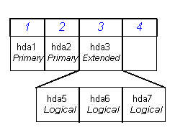
Identifying Partitions
Naming partitions
sdx1 – sdx4
Primary Partitions recorded in the partition table
sdx5 – sdx63
Logical partitions
Sda1
Sda2
Sda3
Sda5
Sda6
Sda7
Note: You can have up to 4 primary partitions created in your
system, while there can be only one extended partition.

Slide 11
Options for Partitioning
DOS fdisk program
Very limited Linux support
Linux fdisk program (we use this)
similar to DOS fdisk, but more features available
can only be used under Linux/UNIX
parted can handle more partition table types (e.g. GPT)
Disk Druid program
Part of the Fedora installation system
Cannot be run on its own
gparted (Fedora, Ubuntu)
Gnome Partitioning Editor: GUI based partitioning
only runs from within Linux/UNIX

Slide 12
Linux fdisk command
fdisk [options] device
command-line partition table manipulator for Linux
allows for viewing or modifying existing partition table and/or creating new partition(s) for a specified device
can set Partition Type for most of the common files systems in use today
fdisk –l /dev/sda

Slide 13
Add a disk
power down machine (or virtual machine)
add hard disk
power up machine
verify the new disk was detected (following slide)
if the disk was brand new, it won't be partitioned (our example is this case)
if the disk is being reused, be sure you can identify its partitions and you do not need the data

Slide 14
dmesg: kernel ring buffer
http://teaching.idallen.com/cst8207/14w/notes/580_system_log_files.html
kernel messages are kept in a ring buffer
common way to access the boot messages, including device discovery
dmesg
example: look for disk discovery:
dmesg | grep sd
(another way): look at disks/partitions that the kernel knows about:
cat /proc/partitions

Slide 15
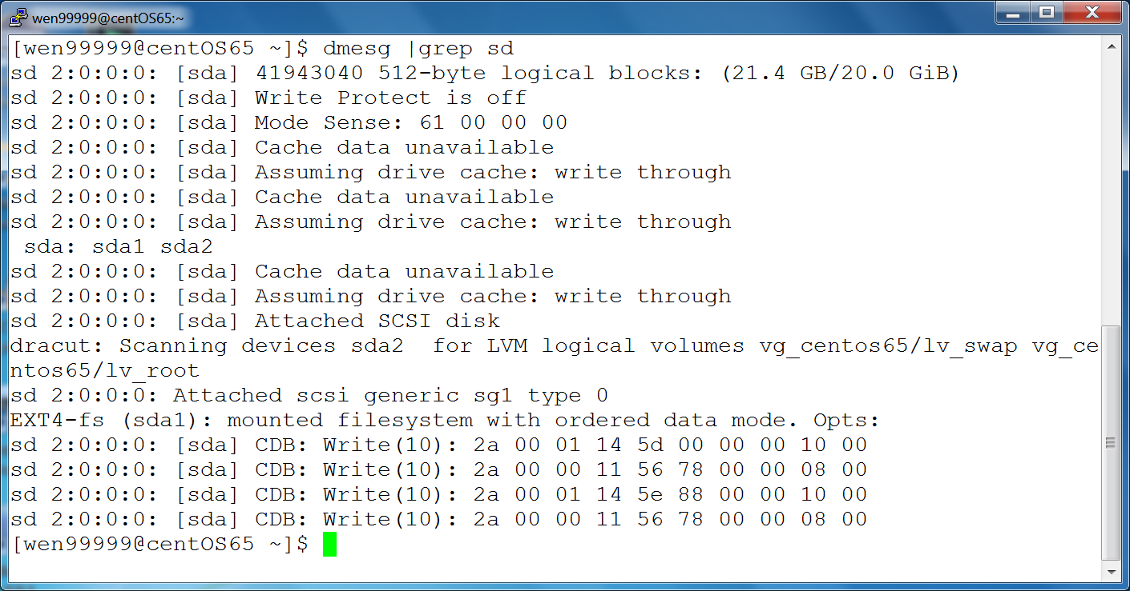
dmesg

Slide 16
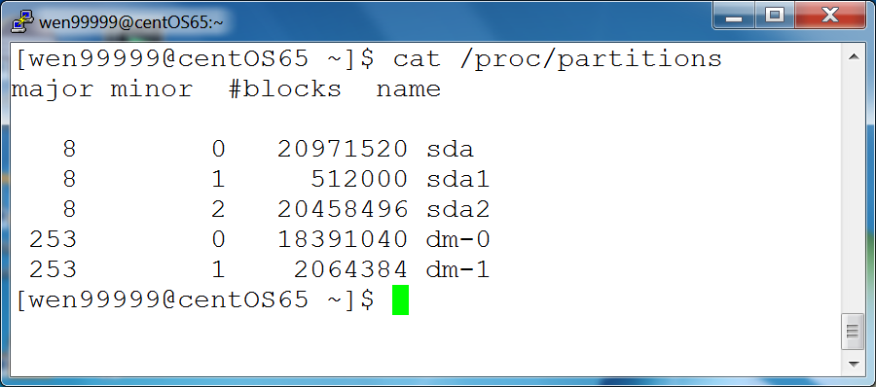
/proc/partitions

Slide 17
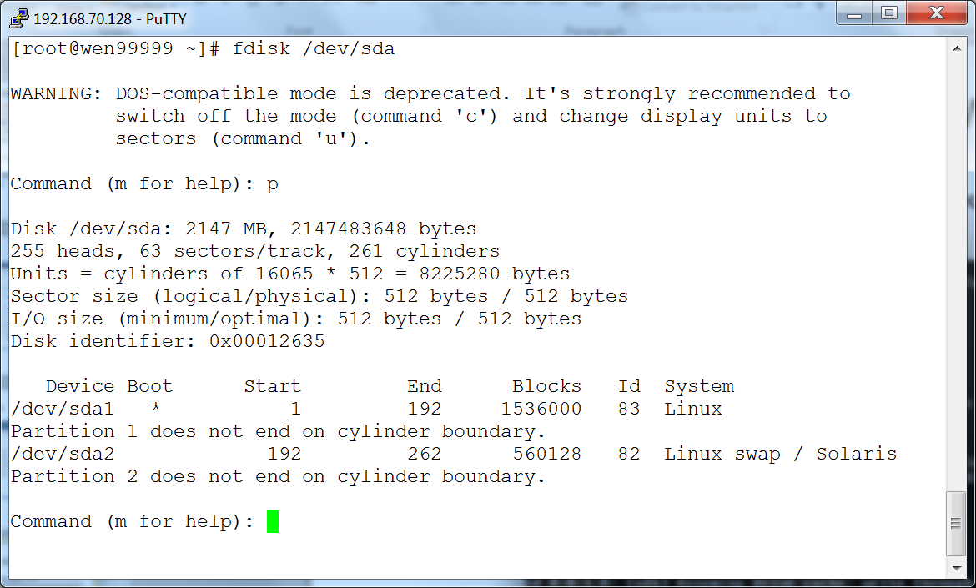
Create partition on new disk
use fdisk to partition the new disk

Slide 18
File systems (8207 review)
http://teaching.idallen.com/cst8207/14w/notes/720_partitions_and_file_systems.html

Slide 19
Linux/Unix mounting
/dev/sda2
/
var/ tmp/ home/
file1 afile dir1/
file2 bfile file1
file 2
/dev/sda3
/
wjiang/ idallen/ donellr/
file1 afile file2
file file

Slide 20
Linux/Unix mounting
mount /dev/sda3 /home
/dev/sda2
/
var/ tmp/ home/
file1 afile dir1/
file2 bfile file1
file 2
/dev/sda3
home/
wjiang/ idallen/ donellr/
file1 afile file2
file file
the /home directory name still on /dev/sda2
the contents of /home are on /dev/sda3
the previous contents of /home are hidden

Slide 21
Linux/Unix mounting
touch /home/donellr/file3
/dev/sda2
/
var/ tmp/ home/
file1 afile dir1/
file2 bfile file1
file 2
/dev/sda3
home/
wjiang/ idallen/ donellr/
file1 afile file2
file file file3

Slide 22
Linux/Unix mounting
umount /dev/sda3
/dev/sda2
/
var/ tmp/ home/
file1 afile dir1/
file2 bfile file1
file 2
/dev/sda3
/
wjiang/ idallen/ donellr/
file1 afile file2
file file file3

Slide 23
/etc/fstab
fsck, mount, and umount use this file
man 5 fstab
note that records for swap space appear in /etc/fstab, although swap space is not a filesystem (files are not stored in swap space)
first field: device name
second field: mount point
third field: type
fourth field: mount options
fifth field: backup related (dump program)
sixth field: file system check order

Slide 24
/etc/fstab commands
mount –a
issued as part of the boot process
all file systems listed in /etc/fstab will be mounted accordingly (except those with "noauto" option or "ignore" file system type)
mount <mount point>
mount will consult /etc/fstab to find the device and options for that mount point, and mount it
mount <device>
mount will consult /etc/fstab to find the mount point and options for that mount point, and mount it

Slide 25
/etc/fstab: device name
device name, the first field, names the block special device (e.g. /dev/sda1) on which the file system resides
the first field can also be expressed in terms of LABEL or UUID (e.g. LABEL=root) (e.g. see the /etc/fstab on our CentOS 6.5 machines)
blkid command prints the UUIDs of the system's block devices
e2label command prints/sets file system labels

Slide 26
/etc/fstab: mount point
The mount point is the directory on which the file system should be mounted
swap is not a file system but is still controlled by /etc/fstab, so the mount point is none

Slide 27
/etc/fstab: file system type
ext4 is the file system type we use often
/proc/filesystems contains the list of file systems supported by the currently running kernel
swap for swap space
ignore for an unused filesystem
none for bind mounts

Slide 28
/etc/fstab: mount options
fourth field in /etc/fstab
expressed as a comma-separated list
different file systems support different options (see man 8 mount)
defaults: a set of default options
example options common to all file system types:
noauto: do not mount when "mount –a" called
user: allow a user to mount
owner: allow device owner to mount

Slide 29
/etc/fstab: options (cont'd)
mount options
on CentOS 6.5, "defaults" means
rw: read and write
dev: interpret device nodes
suid: setuid and setgid bits take effect
exec: permit execution of binaries
auto: mount automatically due to "mount -a"
nouser: regular users cannot mount
async: file I/O done asynchronously
relatime: update access times a certain way
other options:
these are for quota utilities to see rather than mount
usrquota
grpquota

Slide 30
/etc/fstab: dump
the dump program uses this field to determine which file systems should be backed up by the dump command
the dump program can back up an entire file system to tape, for example
dump supports incremental backups
when restoring, it can provide an index of what's in the file system, do partial restores, etc
we don't use dump in this course

Slide 31
/etc/fstab: fsck order
the sixth and last field is used to determine the order in which file system checks are done at boot
root file system: 1
other file systems: 2
no fsck: 0

Slide 32
/etc/mtab and /proc/mounts
/etc/mtab is used by mount and umount to keep track of what is currently mounted
mount command (no args) prints this file
/proc/mounts is the kernel's list of what's mounted, and might be more up-to-date than /etc/mtab

Slide 33
Adding a disk
# migrating the /usr directory to be a separate partition on new disk
shut down machine
connect new disk to machine
power on machine
partition new disk (fdisk command)
make filesystem in new partition (mkfs command)
single user mode (shutdown command)
ensure target directory is backed up
move the target directory out of way (/usr to /usr1) (mv command)
create the mount point (to replace dir we just moved, same name)
mount new filesystem (mount command)
/usr1/bin/rsync –aHv /usr1/. /usr (notice where rsync is!)
add a record for the new filesystem /etc/fstab
exit, to return to runlevel 3
remove /usr1 (content should be backed up)

Slide 34
device busy
when trying to unmount a filesystem, you might get an error:
umount: /dirname: device is busy
probably some process is using the filesystem (it's busy -- make sure you're not in that directory!)
lsof /mountpoint # list open files in the filesystem mounted on /mountpoint
lsof +D /directory
this will show you what processes are using the directory or (+D) any directory under it

Slide 35
lsof and fuser
Note the difference between a mountpoint and a directory
mountpoint: both of these commands will apply to the entire filesystem mounted there
directory: both of these commands will apply to just that directory, not recursively every subdirectory underneath it
summary of lsof:
http://www.thegeekstuff.com/2012/08/lsof-command-examples/
fuser: similar in purpose to lsof
examples:
fuser /mountpoint # all processes using the filesystem mounted at /mountpoint
fuser /home/dir # all processes using the directory dir
summary of fuser:
http://www.thegeekstuff.com/2012/02/linux-fuser-command/

