Slide 1
CST8177 – Linux II
Review of Fundamentals (cont’d)
Todd Kelley
kelleyt@algonquincollege.com

Slide 2
Topics
change your password on CLS if you haven’t already
the filesystem
access permissions
symbolic links
hard links

Slide 3
Variables
Variables for general use (variables that are not environment variables) have lower case names
Environment variables are indicated by their UPPER CASE names: SHELL, VISUAL, etc
It's usually best to put variable expansions inside double quotes, to protect any special characters that might be inside the variable:
echo "$somevar"
if somevar contained the * character, the double quotes stop the shell from globbing it

Slide 4
Setting Variables
set the variable myvar to have value value
myvar=value
Note, to make this variable setting visible in sub processes we use export
export myvar=value
or
myvar=value
export myvar

Slide 5
Variable setting for command
set the myvar variable to have a null value, then run the value command with that variable setting in effect
myvar= command
Notice that if you try mistakenly use this to try to set the value of myvar to value
myvar= value
in this case you are actually trying to run a command called value

Slide 6
Variable setting for command (cont’d)
The usual way to use this mechanism is something like
VISUAL=nano vipw
This means to set the value of the environment VISUAL variable to nano, and use that while the vipw command runs

Slide 7
Setting Variables Mistakes
set the myvar variable to have a null value, then run the value command with that variable setting in effect
myvar= value
run the myvar command with one argument, namely =value
myvar =value
run the myvar command with two arguments, namely = and value
myvar = value

Slide 8
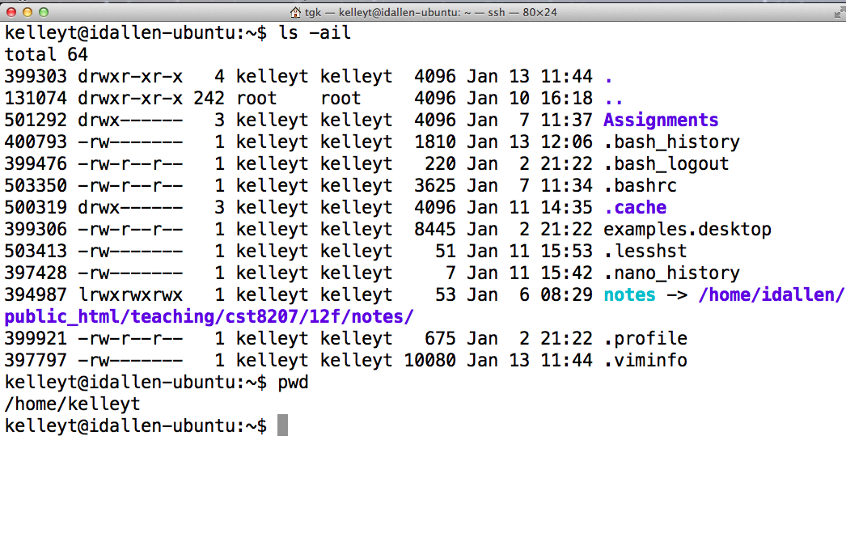
File Permissions

Slide 9
Typical directory and file
inode 399306 -rw-r--r-- access time modification time change time …etc…
data blocks for the file there is no filename here the filename(s) (at least one) are stored in directories
inode 399303 drwxr-xr-x access time modification time change time …etc…
. | inode 399303
.. | inode 131074
examples.desktop | inode 399306
Assignments | inode 501292
…etc… | …etc…

Slide 10
File Permissions (cont’d)
inode 399303 drwxr-xr-x access time modification time change time …etc…
. | inode 399303
.. | inode 131074
examples.desktop | inode 399306
Assignments | inode 501292
…etc… | …etc…
Need read (r) on directory to read this column
Need search (x) on directory to access this column
Need write (w) and search (x) on directory to change first column

Slide 11
File Permissions (cont’d)
inode 399306 -rw-r--r-- access time modification time change time …etc…
data blocks for the file there is no filename here the filename(s) (at least one) are stored in directories
Need search (x) on directory this file is in to access this info on the file’s inode
Need read (r) / write (w) / execute (x) on file to read / write / execute this file (contents)

Slide 12
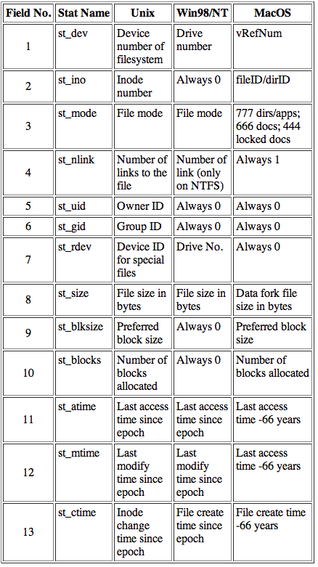
File Attributes

Slide 13
Extending Unix
create a command with basic scripting
put “#!/bin/sh –u” at very beginning of file
put commands in file
make file executable
put the file in a directory that is in $PATH
http://teaching.idallen.ca/cst8207/13f/notes/400_search_path.html
Not a good idea to put “.” in PATH
Security implications of putting “current directory” , “.” in PATH
PATH=.:$PATH
demonstration of how the bad guy can arrange for you to inadvertently run their malicious commands as you

