Slide 1
CST8177 – Linux II
Review of Fundamentals (cont’d)

Slide 2
Topics
change your password on CLS if you haven’t already
the filesystem
access permissions
symbolic links
hard links

Slide 3
Variables
Variables for general use (variables that are not environment variables) have lower case names
Environment variables are indicated by their UPPER CASE names: SHELL, VISUAL, etc
It's usually best to put variable expansions inside double quotes, to protect any special characters that might be inside the variable:
echo "$somevar"
if somevar contained the * character, the double quotes stop the shell from globbing it

Slide 4
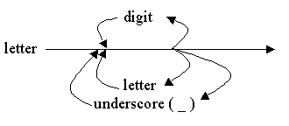
User-defined variables
The user variable name can be any sequence of letters, digits, and the underscore character, but the first character must be a letter.
To assign a value to a variable:
number=25
name="Bill Gates"
There cannot be any space before or after the “=“
Internally, all values are stored as strings.

Slide 5
Setting Variables
set the variable myvar to have value value
myvar=value
Note, to make this variable setting visible in sub processes we use export
export myvar=value
or
myvar=value
export myvar

Slide 6
Variable setting for command
set the myvar variable to have a null value, then run the value command with that variable setting in effect
myvar= command
Notice that if you try mistakenly use this to try to set the value of myvar to value
myvar= value
in this case you are actually trying to run a command called value

Slide 7
Variable setting for command (cont’d)
The usual way to use this mechanism is something like
VISUAL=nano vipw
This means to set the value of the environment VISUAL variable to nano, and use that while the vipw command runs

Slide 8
Setting Variables Mistakes
set the myvar variable to have a null value, then run the value command with that variable setting in effect
myvar= value
run the myvar command with one argument, namely =value
myvar =value
run the myvar command with two arguments, namely = and value
myvar = value

Slide 9
Unix Files
Sobel, Chapter 6
160_pathnames.html Unix/Linux Pathnames (absolute, relative, dot, dot dot)
450_file_system.html Unix/Linux File System - (correct explanation)
460_links_and_inodes.html Hard links and Unix file system nodes (inodes)
460_symbolic_links.html Symbolic Links - Soft Links - Symlinks
500_permissions.html Unix Modes and Permissions
510_umask.html Umask and Permissions

Slide 10
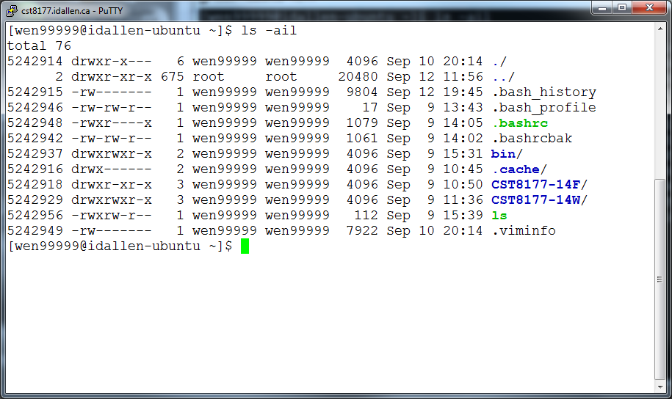
File Permissions

Slide 11
Typical directory and file
inode 5242946 -rw-rw-r-- access time modification time change time …etc…
data blocks for the file there is no filename here the filename(s) (at least one) are stored in directories
inode 5242914 drwxr-x--- access time modification time change time …etc…
. | inode 5242914
..
.bash_history | inode 5242915
.bash_profile | inode 5242946
…etc… | …etc…

Slide 12
File Permissions (cont’d)
inode 5242914 drwxr-x--- access time modification time change time …etc…
. | inode 5242914
..
.bash_history | inode 5242915
.bash_profile | inode 5242946
…etc… | …etc…
Need read (r) on directory to read this column
Need search (x) on directory to access this column
Need write (w) and search (x) on directory to change first column

Slide 13
File Permissions (cont’d)
inode 5242946 -rw-rw-r-- access time modification time change time …etc…
data blocks for the file there is no filename here the filename(s) (at least one) are stored in directories
Need search (x) on directory this file is in to access this info on the file’s inode
Need read (r) / write (w) / execute (x) on file to read / write / execute this file (contents)

Slide 14
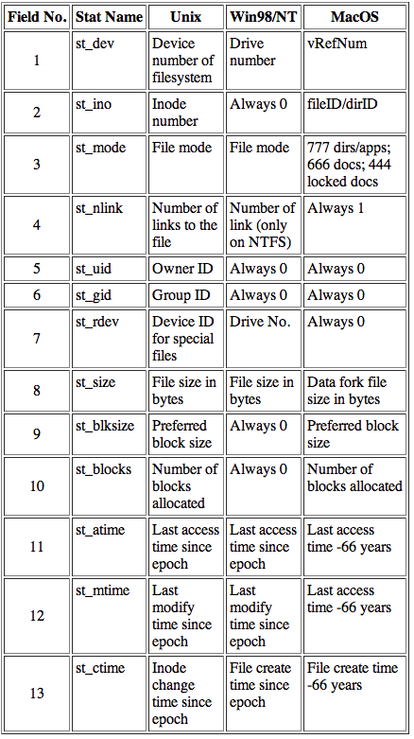
File Attributes

Slide 15
Information given by long listing: ls -l
10 characters
file type as the first letter
access modes (remaining letters)
Link count
number of links to this file or directory
User-owner Login Name
user who owns the file/directory
based on owner UID
User-owner Group Name
group who owns the file/directory
based on owner GID
File Size
size (in bytes or K) of the file/directory
Date/Time Modified
date and time when last created / modified / saved
File Name
actual file/directory name

Slide 16
File Types
Linux recognizes and identifies several file types, which is coded into the first letter of the first field of information about the file:
- (dash)a regular file
b block device special file
c character device special file
d a directory
l a symbolic (soft) link
p a named pipe or FIFO
s socket special filename

Slide 17
File Access Privileges
In Linux, 3 types of access permissions or privileges can be associated with a file:
read (r) grants rights to read a file
write (w) grants rights to write to, or change, a file
execute (x) grants rights to execute the file (to run the file as a command)
All 3 permissions can then be applied to each of 3 types of users:
User: owner of the file
Group: group to which user must belong to gain associated rights
Others: not User and not member of Group (sometimes called “World” or “Everybody”)

Slide 18
Octal representation of permissions

Slide 19
Directory Access Privileges
The same three types of access permissions or privileges are associated with a directory, but with some differences:
read (r) rights to read the directory
write (w) rights to create or remove in the directory
execute/search (x) rights to access the directory
meaning, cd into the directory, or access inodes it contains, or “pass through”
All three permissions can then be applied to each of three types of users as before.
User owner/creator of the file
Group group to which user must belong
Others everyone else (Rest-of-world)

Slide 20
Linux File Permissions
Three special access bits. These can be combined as needed.
SUID - Set User ID bit
When this bit is set on a file, the effective User ID of a process resulting from executing the file is that of the owner of the file, rather than the user that executed the file
For example, check the long listing of /usr/bin/passwd – the SUID bit makes this program run as root even when invoked by a regular user – allowing regular users to change their own password
chmod 4xxx file-list
chmod u+s file-list

Slide 21
Linux File Permissions
SGID - Set Group ID bit
Similar to SUID, except an executable file with this bit set will run with effective Group ID of the owner of the file instead of the user who executed the file.
chmod 2xxx file-list
chmod g+s file-list

Slide 22
Linux File Permissions
sticky bit (restricted deletion flag)
The sticky bit on a directory prevents unprivileged users from removing or renaming a file in the directory unless they are the owner of the file or the directory
for example, /tmp is a world-writeable directory where all users need to create files, but only the owner of a file should be able to delete it.
without the sticky bit, hostile users could remove all files in /tmp; whereas with the sticky bit, they can remove only their own files.
chmod 1xxx dir-list
chmod +t dir-list

Slide 23
Linux File Permissions
The permissions a user will have is determined in this way:
If the user is the owner of the file or directory, then the user rights are used.
If the user is not the owner but is a member of the group owning the file or directory, then the group rights are used.
If the user is neither the owner nor a part of the group owning the file, then the other rights are used.
NOTE: It is possible to give the “world” more permissions that the owner of the file. For example, the unusual permissions -r--rw-rw- would prevent only the owner from changing the file – all others could change it!

Slide 24
umask
The permissions assigned to newly created files or directories are determined by the umask value of your shell.
Commands:
umask - display current umask
umask xyz - sets new umask to an octal value xyz
permissions on a newly created file or directory are calculated as follows:
start with a “default” of 777 for a directory or 666 for a file
for any 1 in the binary representation of the umask, change the corresponding bit to 0 in the binary representation of the default
umask is a reverse mask: the binary representation tells you what bits in the 777 or 666 default will be 0 in the permissions of the newly created file or directory

Slide 25
umask examples (Files)
if umask is 022
binary umask representation: 000010010 = 022
default file permissions 666: 110110110
permissions on new file: 110100100 = 644
if umask is 002
binary umask representation: 000000010 = 002
default file permissions 666: 110110110
permissions on new file: 110110100 = 664
if umask is 003
binary umask representation: 000000011 = 003
default file permissions 666: 110110110
permissions on new file: 110110100 = 664

Slide 26
umask examples (Files, cont’d)
notice that for files, a umask of 003 ends up doing the same thing as a umask of 002
Why?

Slide 27
umask examples (Directories)
if umask is 022
binary umask representation: 000010010 = 022
default dir permissions 777: 111111111
permissions on new dir : 111101101 = 755
if umask is 002
binary umask representation: 000000010 = 002
default dir permissions 777: 111111111
permissions on new dir : 111111101 = 775
if umask is 003
binary umask representation: 000000011 = 003
default dir permissions 777: 111111111
permissions on new dir : 111111100 = 774

Slide 28
umask examples (Dirs, cont’d)
notice that for directories, a umask of 003 gives different results than a umask of 002
Why?

Slide 29
Linux File Permissions
It is important for the Linux file system manager to govern permissions and other file attributes for each file and directory, including
ownership of files and directories
access rights on files and directories
The 3 timestamps seen in stat (man stat)
The information is maintained within the file system information (inodes) on the hard disk
This information affects every file system action.

Slide 30
Linux Basic Admin Tools
chown owner[:group] files
Change ownership of files and directories (available for root only)
Examples:
chown guest:guest file1 dir2
change ownership of file1 and dir2 to user guest and group guest
chown guest dir2
change ownership of dir2 to user guest but leave the group the same
chown :guest file1
change ownership of file1 to group guest but leave the user the same (can also use chgrp)

Slide 31
Linux Basic Admin Tools
chmod permissions files
Explicitly change file access permissions
Examples:
chmod +x file1
changes file1 to have executable rights for user/group/other, subject to umask
chmod u+r,g-w,o-rw file2
changes file2 to add read rights for user, remove write rights for group and remove both read and write rights for others
chmod 550 dir2
changes dir2 to have only read and execute rights for user and group but no rights for other

Slide 32
Extending Unix
create a command with basic scripting
put “#!/bin/sh –u” at very beginning of file
PATH=/bin:/usr/bin ; export PATH
umask 022
put commands in file
make file executable
put the file in a directory that is in $PATH
http://teaching.idallen.ca/cst8207/14w/notes/400_search_path.html
Not a good idea to put “.” in PATH
Security implications of putting “current directory” , “.” in PATH
PATH=.:$PATH
demonstration of how the bad guy can arrange for you to inadvertently run their malicious commands as you

Slide 33
Internationalization (I18N)
http://teaching.idallen.com/cst8177/14w/notes/000_character_sets.html

